Slide 1
Discrete Math (v.2) & Asymptotics
CS 374

Slide 2
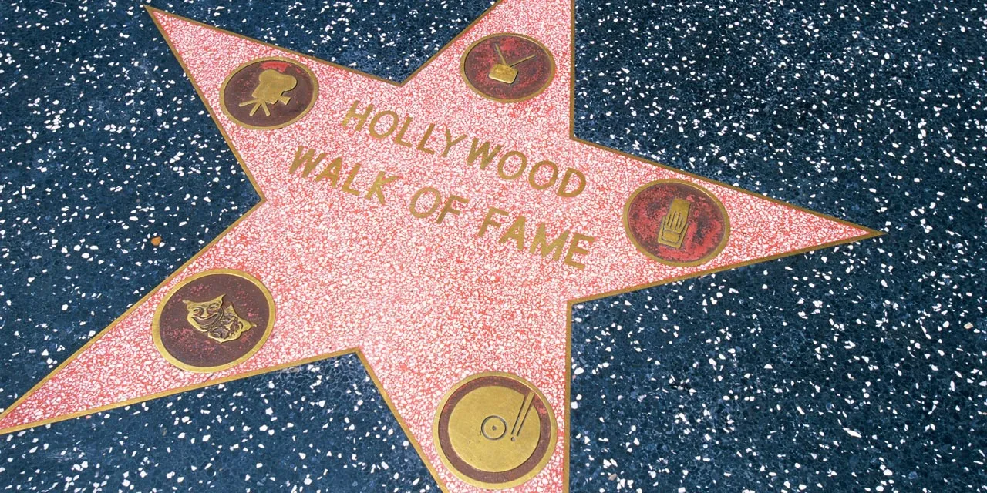
Imagine we are actors

Slide 3
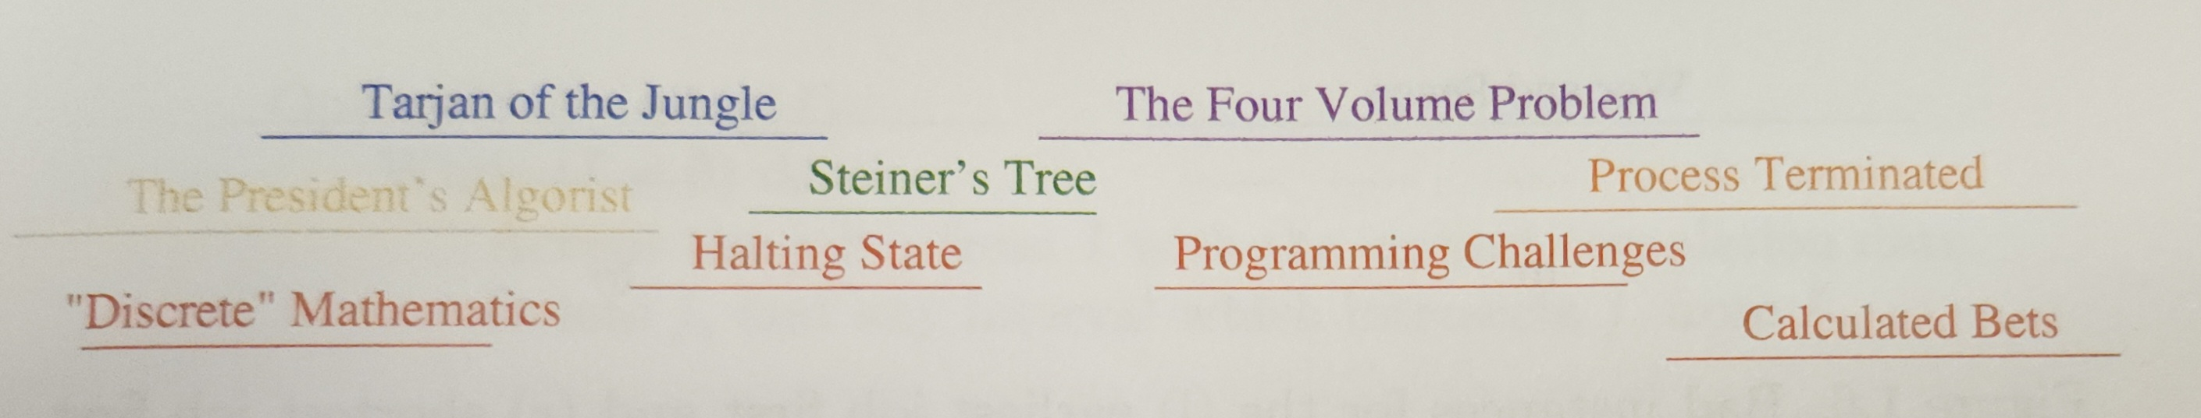
We could schedule to work in the following movies:
Goal: work in the most movies possible.
Displayed as a set of intervals

Slide 4
Option 1:
EarliestJobFirst:
Accept the earliest-starting job j that does not overlap any previously accepted job. Repeat until no more such jobs remain.

Slide 5
Option 2:
ShortestJobFirst:
While the set of movies remains nonempty,
Accept the shortest possible job j.
Delete j from the list, as well as any other job that intersects with j.

Slide 6
Option 3:
ExhaustiveScheduling:
Test all 2^{n} subsets of intervals from the set of movies, and return the largest subset consisting of mutually non-overlapping intervals.

Slide 7
Option 4:
OptimalScheduling:
While the set of movies is not empty:
Accept the job j with the earliest completion date.
Then delete j and any interval which intersects j from the set.

Slide 8
Option 5:
GreedyScheduling:
Select the job j which overlaps the smallest number of other jobs.
Remove j and repeat until no jobs remain.

Slide 9
Which option is the best?
EarliestJobFirst:
Accept the earliest-starting job j that does not overlap any previously accepted job. Repeat until no more such jobs remain.
ShortestJobFirst:
While the set of movies remains nonempty,
Accept the shortest possible job j.
Delete j from the list, as well as any other job that intersects with j.
ExhaustiveScheduling:
Test all 2^{n} subsets of intervals from the set of movies, and return the largest subset consisting of mutually non-overlapping intervals.
OptimalScheduling:
While the set of movies is not empty:
Accept the job j with the earliest completion date.
Then delete j and any interval which intersects j from the set.
GreedyScheduling:
Select the job j which overlaps the smallest number of other jobs.
Remove j and repeat until no jobs remain.

Slide 11
Present the following…
Is it correct? Will it produce the longest possible list of jobs?
If it is incorrect, provide a counterexample.
Is it efficient?
Rate each of these categories out of 10 (1=worst, 10=best)

Slide 12
Induction, attempt 2

Slide 13
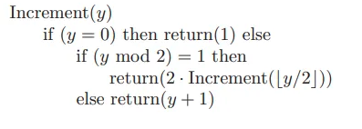
Is this correct?
Prove with induction!

Slide 14
Is this correct?

Slide 15
Extra slide if needed

Slide 16
Combinatorics Cheat Sheet

Slide 17
Why do we need them?
Useful for knowing how many possible options there are.
Helpful for assessing efficiency options

Slide 18
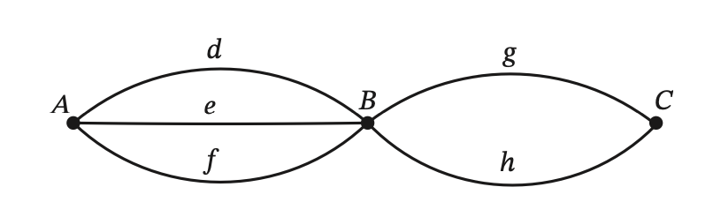
Cheat Sheet
Addition Rule:
If there are several events/decisions that happen, but are only available in separate "universes", add the number of possibilities together.
E.G. I could take one path xor another (impossible to take both). 3 + 2 paths total
Multiplication Rule:
If events must happen in sequence
E.G. I have to choose out of 3, then out of 2. 3*2.
E.G. choosing students to stand in a line
Factorial:
n! = n(n-1)(n-2)(n-3)…(2)(1)

Slide 19
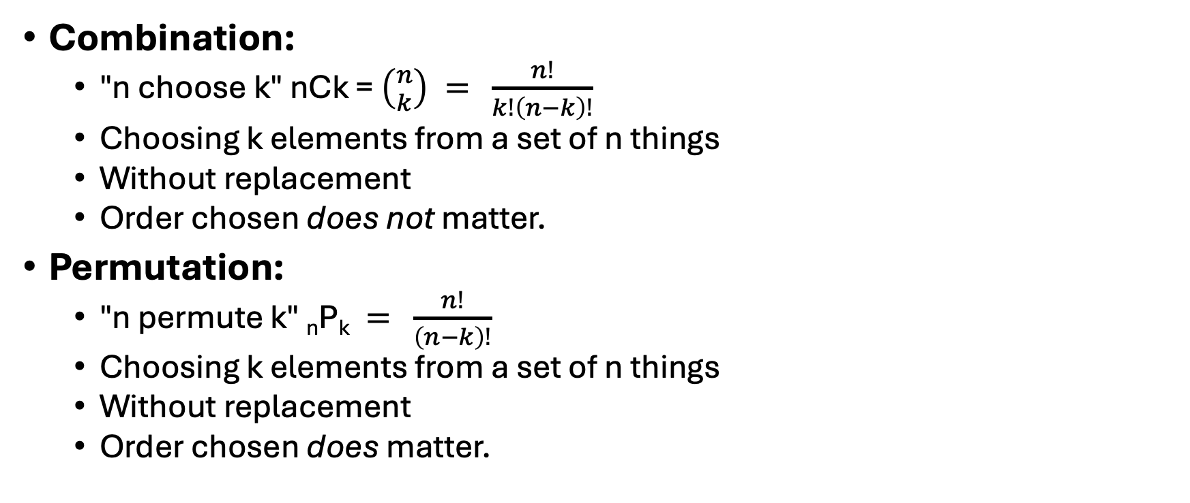
Permutation, Combination
Combination:
"n choose k" nCk = $\left({n \atop k}\right) = \frac{n!}{k!\left(n−k\right)!}$
Choosing k elements from a set of n things
Without replacement
Order chosen does not matter.
Permutation:
"n permute k" _{n}P_{k}$= \frac{n!}{\left(n−k\right)!}$
Choosing k elements from a set of n things
Without replacement
Order chosen does matter.

Slide 20
Example Problem
A hungry group of professional Settlers of Catan players stop at Loard's Ice Cream on the way to their next tournament. Their coach plans to buy each team member a cone. The shop is stocked with 16 flavors. For cones, having chocolate ice cream as the bottom scoop is different from having chocolate as the top scoop. For bowls, it doesn't matter in what order the scoops are added.
If a flavor cannot be chosen more than once, how many possible 3-scoop cones could be ordered?
If a flavor can be chosen more than once, how many possible 5-scoop bowls could be ordered?
If a flavor cannot be chosen more than once, how many possible 4-scoop bowls could be ordered?

Slide 21
Asymptotics

Slide 22
Outline
RAM model of computation
Big-Oh
Growth rates & dominance
How-to do "big O" math
Summations
Logarithms
Notes:
Ton of stuff in the book. We won't look at allll of it.

Slide 23
Let's make up a machine
💭
🖥️
🧐
"Random Access Machine" (RAM)
Gives us a computational model where:
Every simple operation (+, -, *, =, if, call, etc) takes 1 "time step"
Each memory access takes 1 time step
Have as much memory as needed
Doesn't matter if memory is in cache or on disk
Loops/subroutines are not simple operations

Slide 24
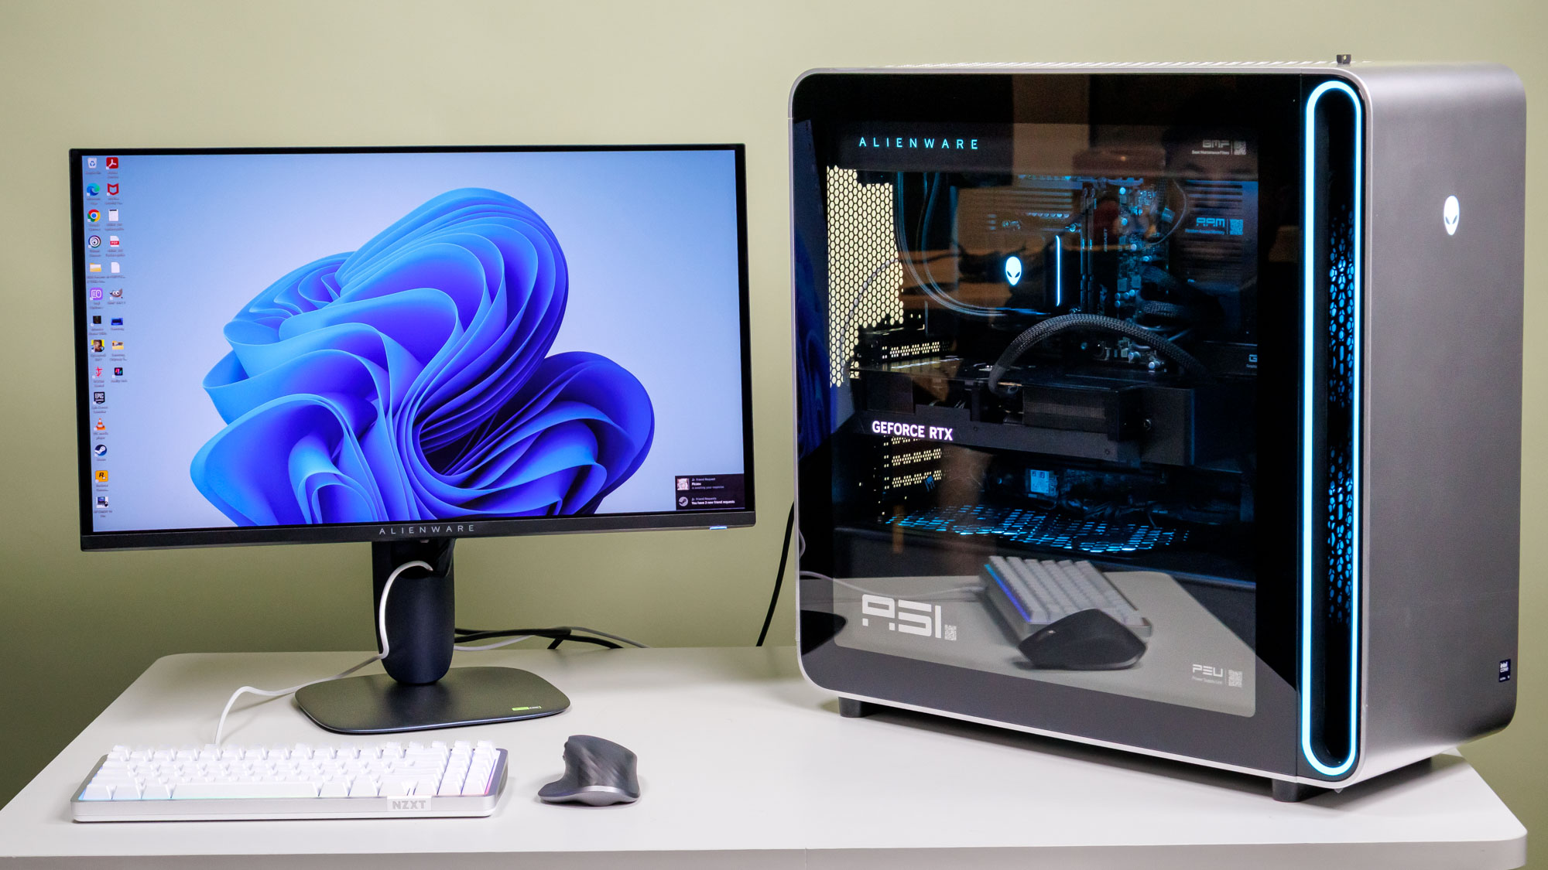


RAM Model
This is an abstract machine that helps us assess algorithm performance.
Lets us evaluate algorithms machine-independently.

Slide 25
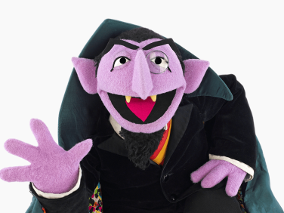
RAM model
Counts the steps taken, the amount of time taken to complete operations
Machine-independent
Language-independent
Notes:
With n as size of input

Slide 26
How many instructions are completed?
int[] a = {1, 2, 3, 4, 5};
int total = 0;
total += a[0];
total += a[1];
total += a[2];
total += a[3];
total += a[4];
System.out.println(total);
#1
Notes:
2^3

Slide 27
How many instructions are completed?
a = [1,2,3,4,5]
total = 0
for x in a:
total += x
print(total)
#2
Notes:
2+1(5)+1

Slide 28
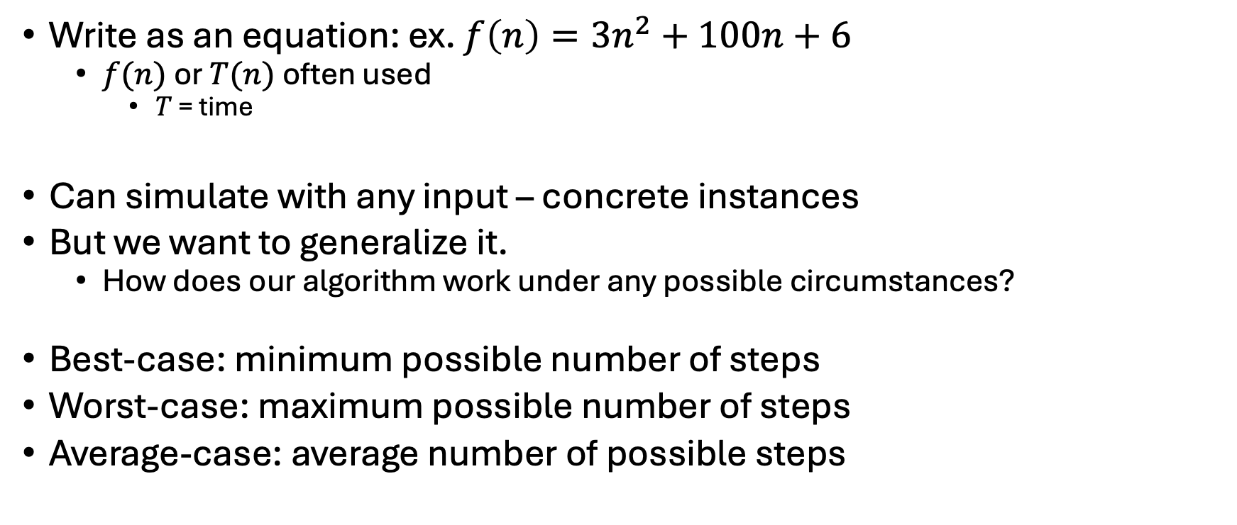
How many instructions done generally?
Write as an equation: ex. $f\left(n\right)=3n^{2}+100n+6$
$f(n)$ or $T(n)$ often used
$T$ = time
Can simulate with any input – concrete instances
But we want to generalize it.
How does our algorithm work under any possible circumstances?
Best-case: minimum possible number of steps
Worst-case: maximum possible number of steps
Average-case: average number of possible steps

Slide 29
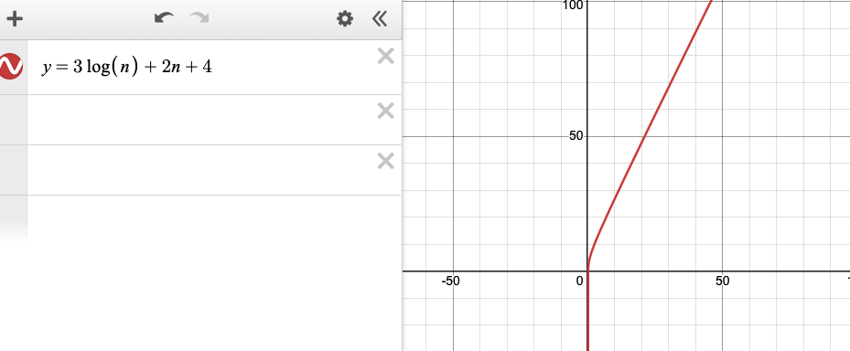
That equation is a function
Can plug it in to desmos

Slide 30
That equation is a function
Positive X-axis: size of data
Doesn't make sense to have 0 or negative data
Positive Y-axis: number of steps the algorithm takes based on the size of the data input
We also care about its long-term behavior

Slide 31
That equation is a function
Long-term behavior = limits!
But Calculus I is not a prerequisite for this course.
We have another way to express this.

Slide 32
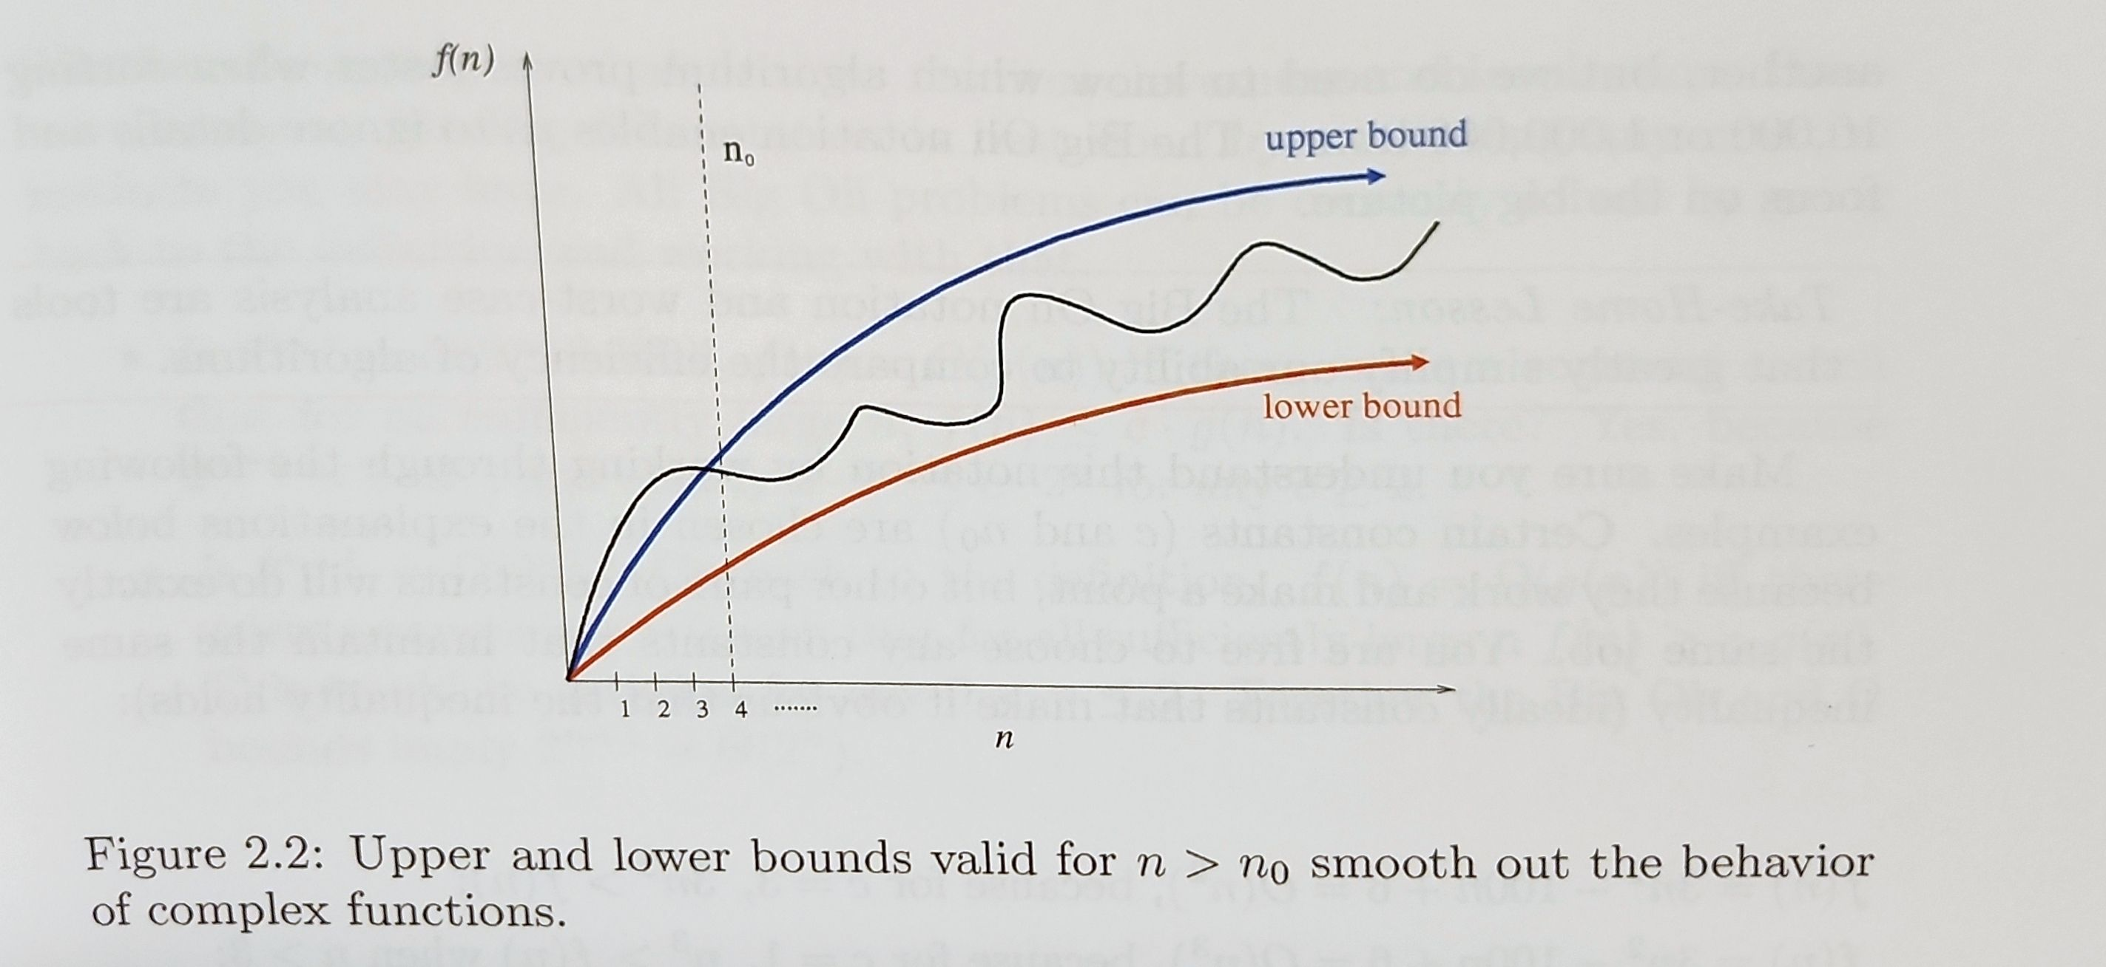
Search for 2 other functions

Slide 33
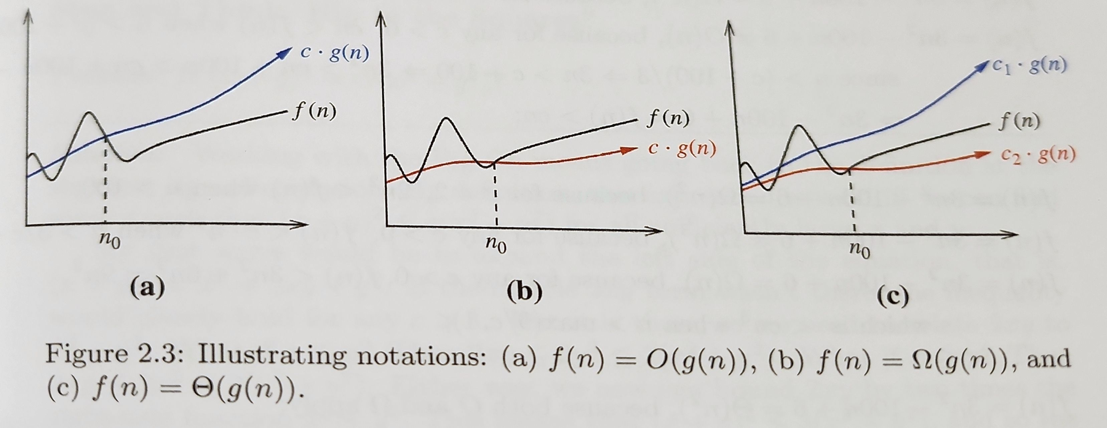
Search for 2 other functions
Notes:
Goal is to find functions that upper and lower bound it.
And find some value n0 such that the upper and lower bound applies.

Slide 34
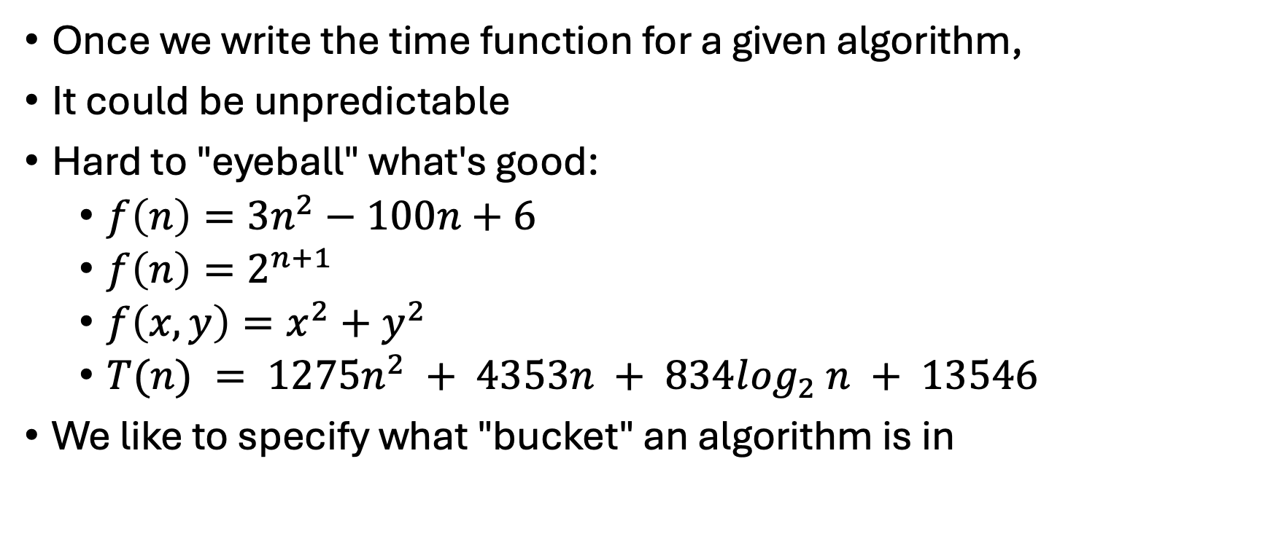
Why we're doing this
Once we write the time function for a given algorithm,
It could be unpredictable
Hard to "eyeball" what's good:
$f\left(n\right)=3n^{2}−100n+6$
$f\left(n\right)=2^{n+1}$
$f\left(x,y\right)=x^{2}+y^{2}$
$T(n) = 1275n^{2} + 4353n + 834l{og}_{2} n + 13546$
We like to specify what "bucket" an algorithm is in

Slide 35
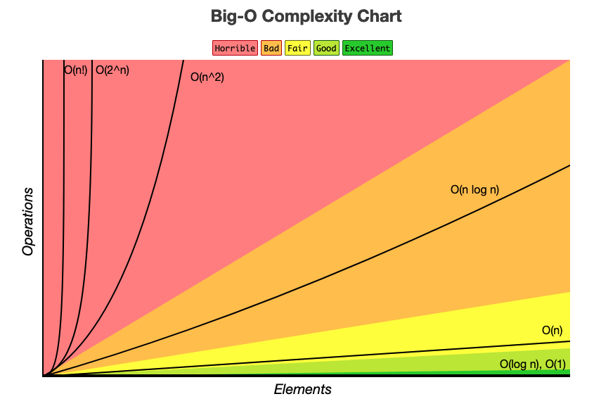
Specifying a bucket
Something that roughly looks like…

Slide 36
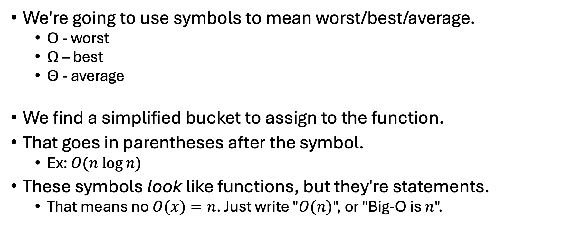
Specifying a bucket
We're going to use symbols to mean worst/best/average.
O - worst
Ω – best
ϴ - average
We find a simplified bucket to assign to the function.
That goes in parentheses after the symbol.
Ex: $O(n log⁡n)$
These symbols look like functions, but they're statements.
That means no $O(x)=n$. Just write "$O(n)$", or "Big-O is $n$".

Slide 37
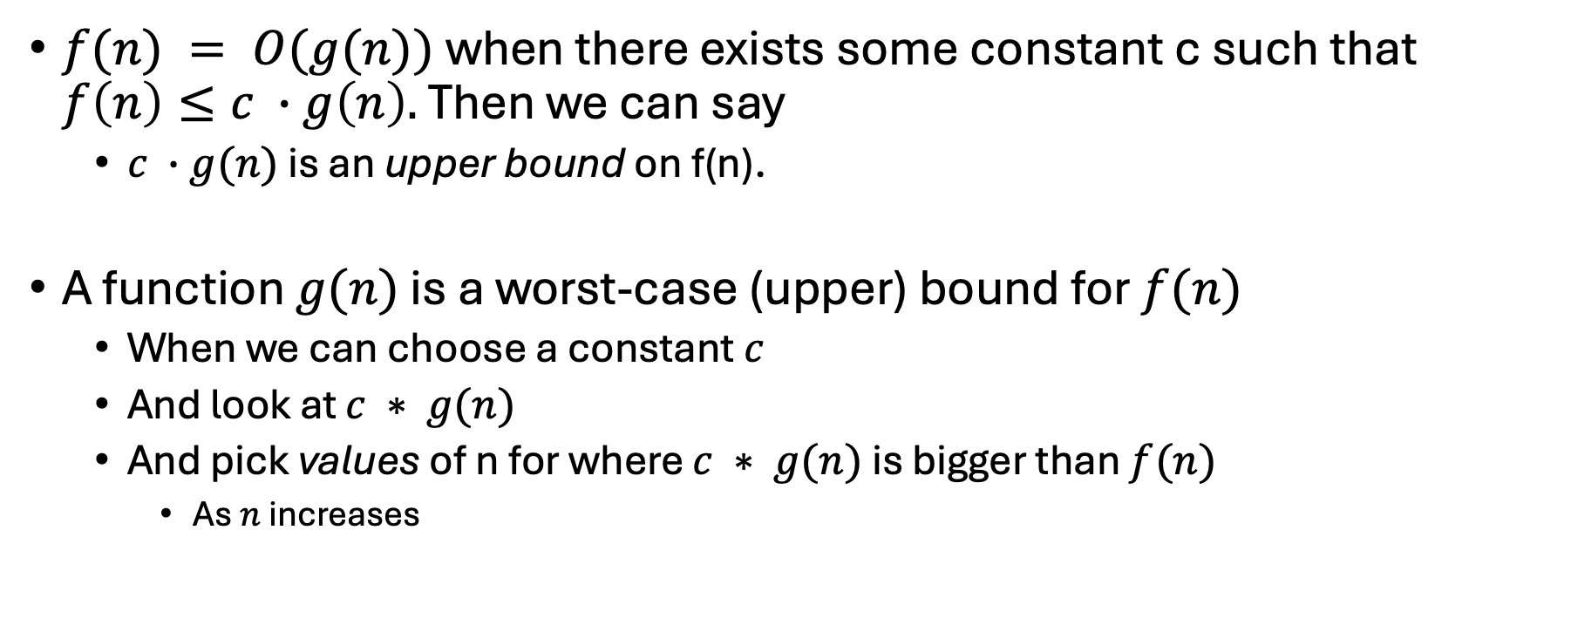
Upper bound
$f(n) = O(g(n))$when there exists some constant c such that $f\left(n\right)≤c ∙g\left(n\right).$ Then we can say
$c ∙g(n)$ is an upper bound on f(n).
A function $g(n)$ is a worst-case (upper) bound for $f(n)$
When we can choose a constant $c$
And look at $c ∗ g(n)$
And pick values of n for where $c ∗ g(n)$ is bigger than $f(n)$
As $n$ increases
Notes:
"a function g(n) is the upper bound for f(n)"

Slide 38
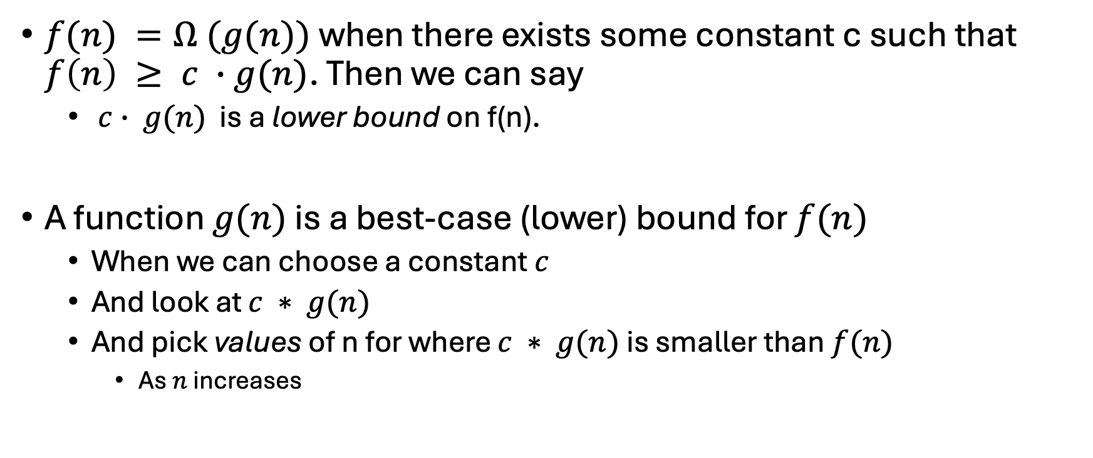
Lower bound
$f(n) =Ω (g(n))$ when there exists some constant c such that $f\left(n\right) ≥ c ∙g(n)$. Then we can say
$c∙ g(n)$ is a lower bound on f(n).
A function $g(n)$ is a best-case (lower) bound for $f(n)$
When we can choose a constant $c$
And look at $c ∗ g(n)$
And pick values of n for where $c ∗ g(n)$ is smaller than $f(n)$
As $n$ increases

Slide 39
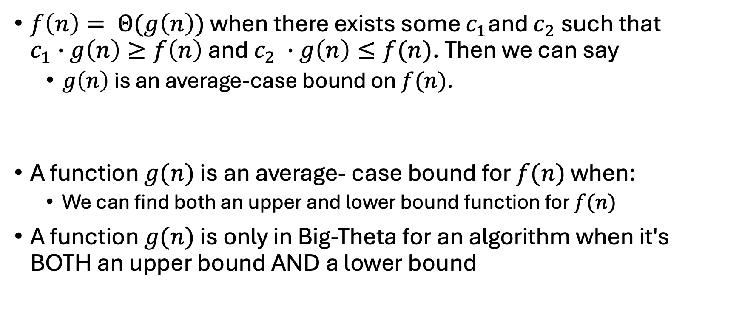
Average-case bound
$f\left(n\right)= Θ(g\left(n\right))$ when there exists some $c_{1}$and $c_{2}$ such that $c_{1}∙g\left(n\right)≥f\left(n\right)$ and $c_{2} ∙g\left(n\right)≤f(n)$. Then we can say
$g\left(n\right)$ is an average-case bound on $f(n)$.
A function $g(n)$ is an average- case bound for $f(n)$ when:
We can find both an upper and lower bound function for $f(n)$
A function $g(n)$ is only in Big-Theta for an algorithm when it's BOTH an upper bound AND a lower bound

Slide 40
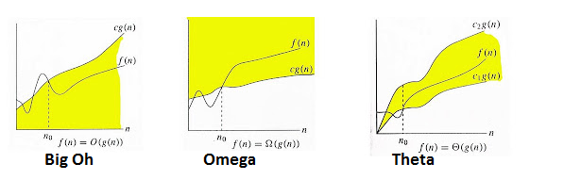
Just different constants multiplied with the function
Notes:
Oh = worst (upper bound)
Omega = best (lower bound)
Theta = average (upp and lower bound)

Slide 41
Big-Theta is a set
Big-Theta is the "average case" function
So, needs both an upper and lower bounds

Slide 42
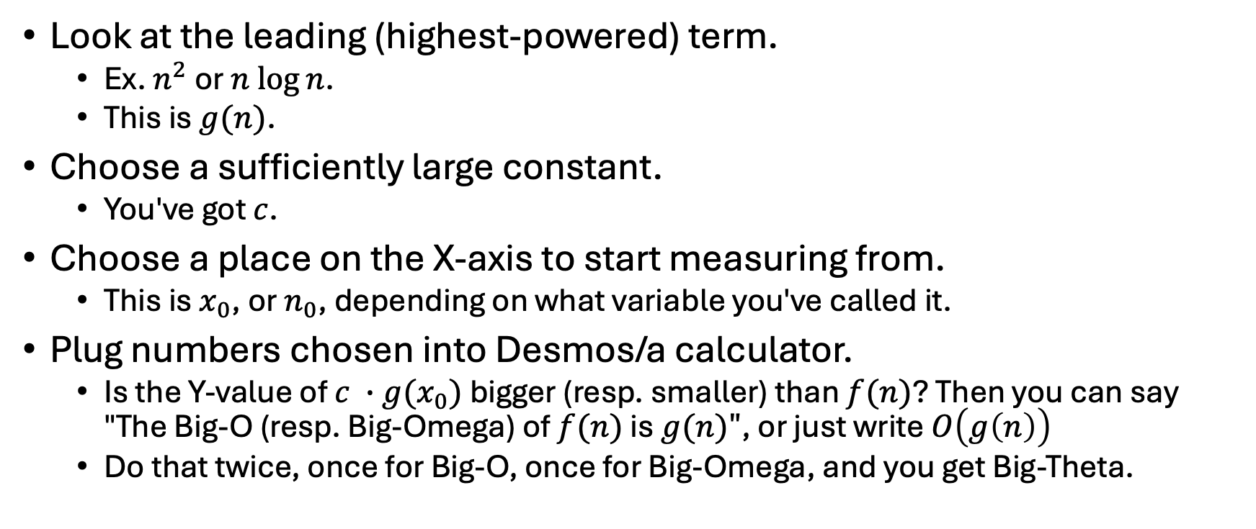
Tips and Tricks
Look at the leading (highest-powered) term.
Ex. $n^{2}$ or $n log⁡n$.
This is $g(n)$.
Choose a sufficiently large constant.
You've got $c$.
Choose a place on the X-axis to start measuring from.
This is $x_{0}$, or $n_{0}$, depending on what variable you've called it.
Plug numbers chosen into Desmos/a calculator.
Is the Y-value of $c ∙g(x_{0})$ bigger (resp. smaller) than $f(n)$? Then you can say "The Big-O (resp. Big-Omega) of $f(n)$ is $g(n)"$, or just write $O\left(g\left(n\right)\right)$
Do that twice, once for Big-O, once for Big-Omega, and you get Big-Theta.

Slide 43
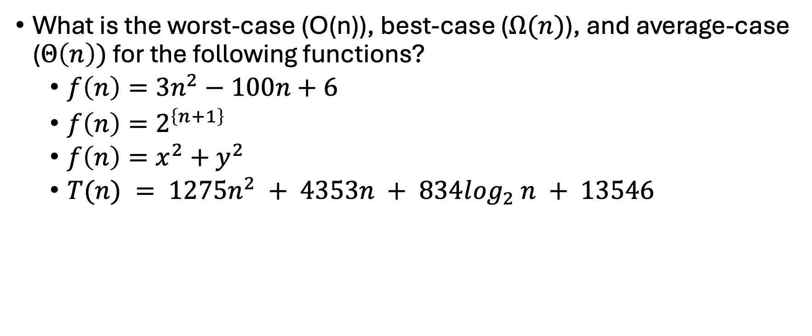
Problems
What is the worst-case (O(n)), best-case ($Ω(n)$), and average-case ($Θ\left(n\right))$ for the following functions?
$f\left(n\right)=3n^{2}−100n+6$
$f\left(n\right)=2^{\left\{n+1\right\}}$
$f\left(n\right)=x^{2}+y^{2}$
$T(n) = 1275n^{2} + 4353n + 834l{og}_{2} n + 13546$
Notes:
Let's do the first one, then you look at some of the others

Slide 44
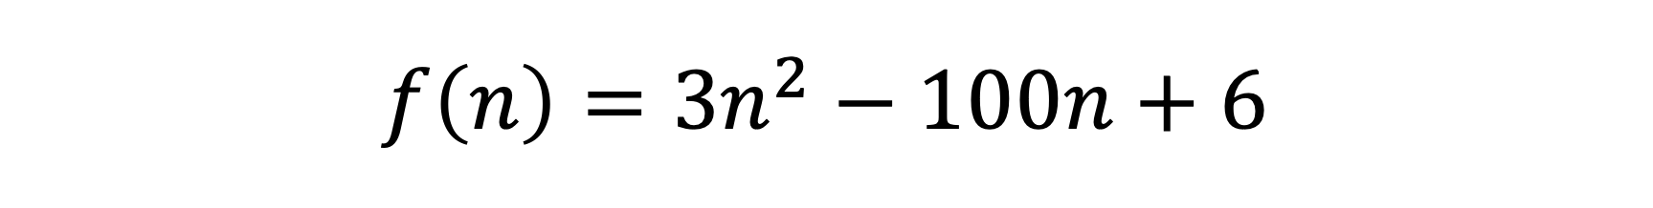
$$f\left(n\right)=3n^{2}−100n+6$$

Slide 45
$$f\left(n\right)=3n^{2}−100n+6$$

Slide 46
$$f\left(n\right)=3n^{2}−100n+6$$

Slide 47
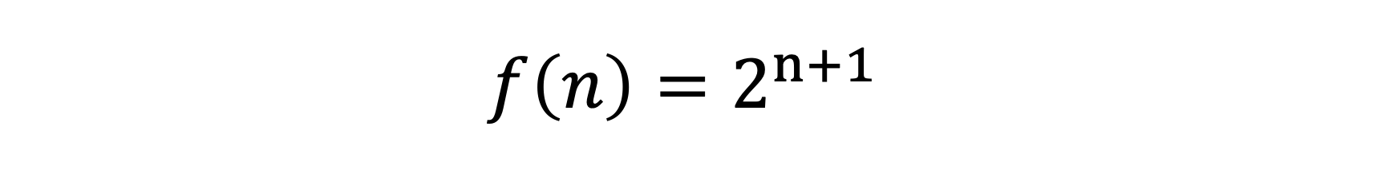
$$f\left(n\right)=2^{n+1}$$

Slide 48
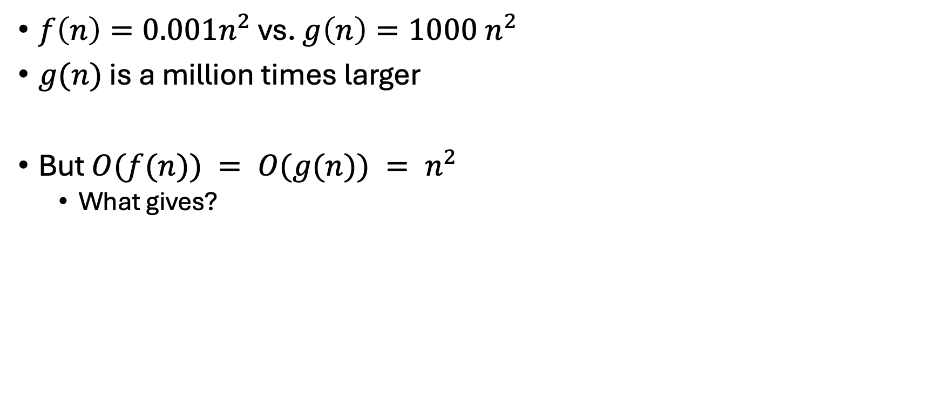
Growth Rates & Dominance Relations
$f\left(n\right)=0.001n^{2}$ vs. $g\left(n\right)=1000 n^{2}$
$g(n)$ is a million times larger
But $O(f(n)) = O(g(n)) = n^{2}$
What gives?

Slide 49
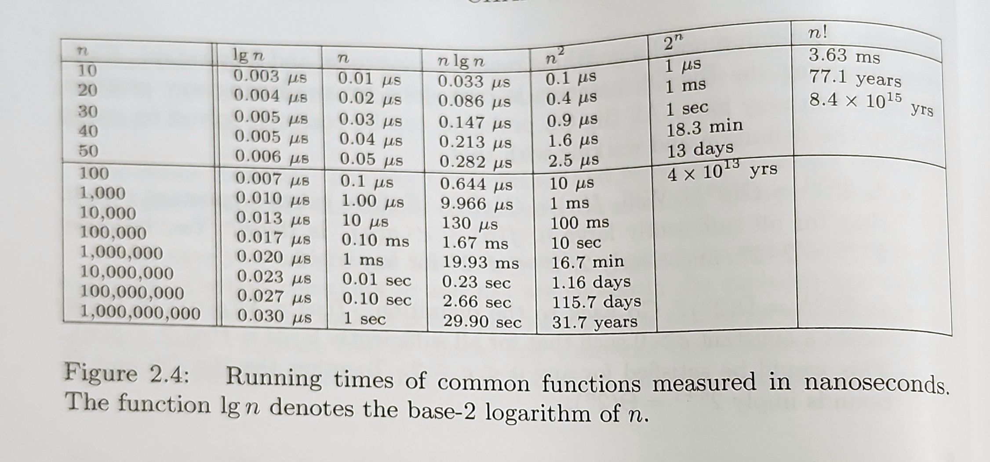
Notes:
Let's talk about this. What do you see?

Slide 50
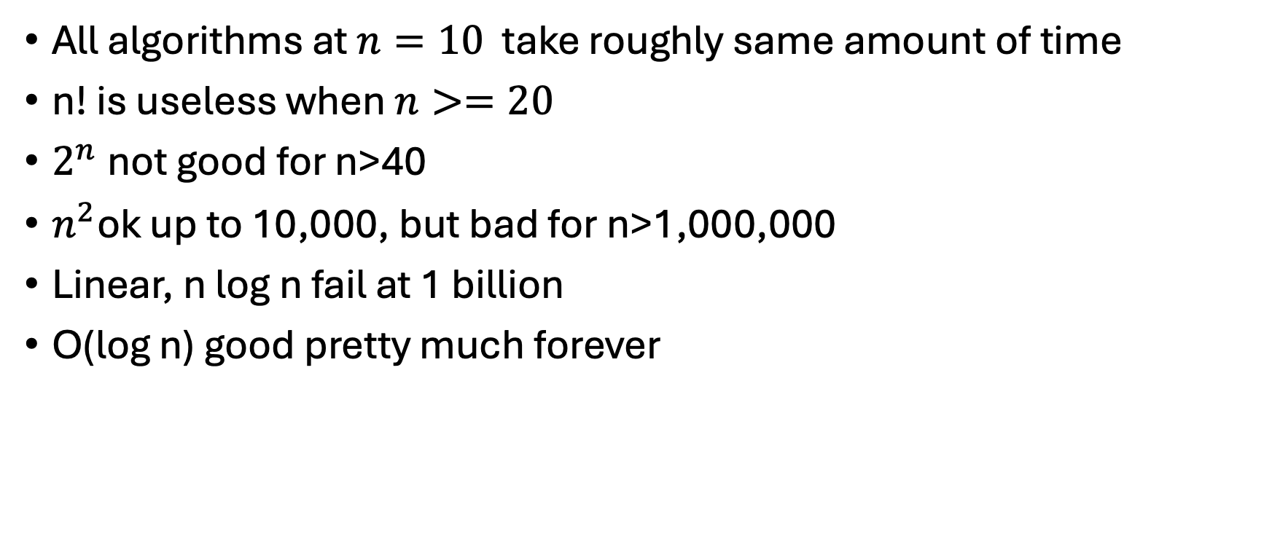
Insights
All algorithms at $n=10$ take roughly same amount of time
n! is useless when $n>=20$
$2^{n}$not good for n>40
$n^{2}$ok up to 10,000, but bad for n>1,000,000
Linear, n log n fail at 1 billion
O(log n) good pretty much forever

Slide 51
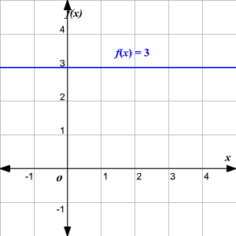
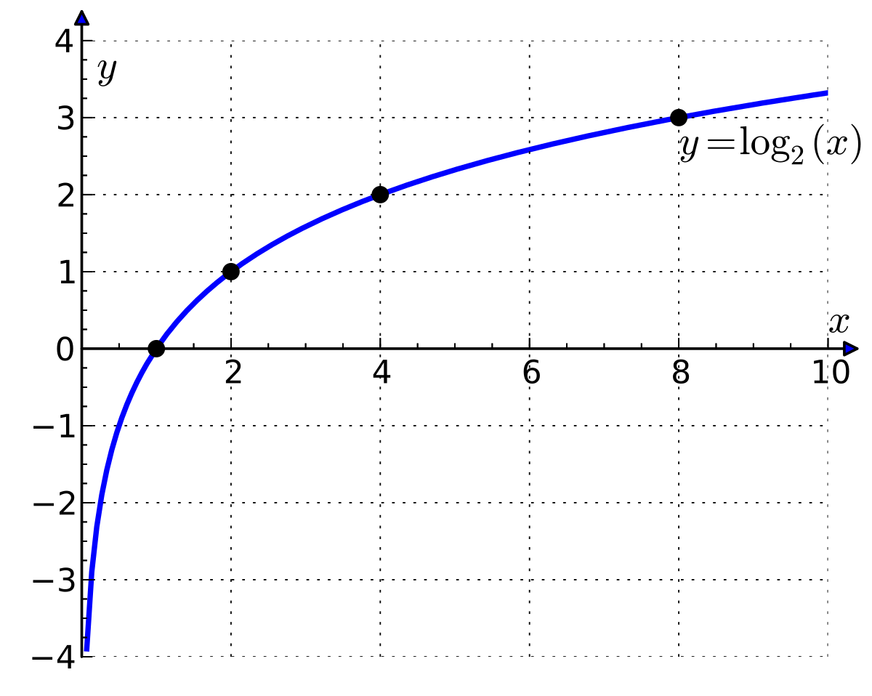
Classes of functions
Constant functions, f(n) = 1
Adding two numbers
Print "The Star Spangled Banner"
Find the minimum of n and 100
Logarithmic functions, f(n) = log n
Binary search
Also called sublinear

Slide 52
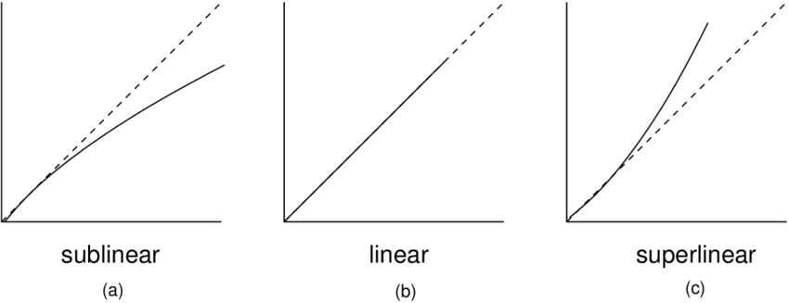
Classes of functions
Linear functions, f(n) = n
Looking at each item once in an n-element array
Find the biggest/smallest
Compute average value
Superlinear functions, f(n) = n log n
Quicksort
Mergesort

Slide 53
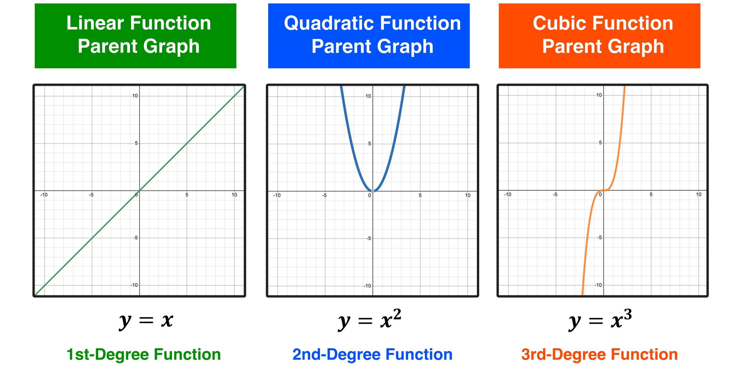
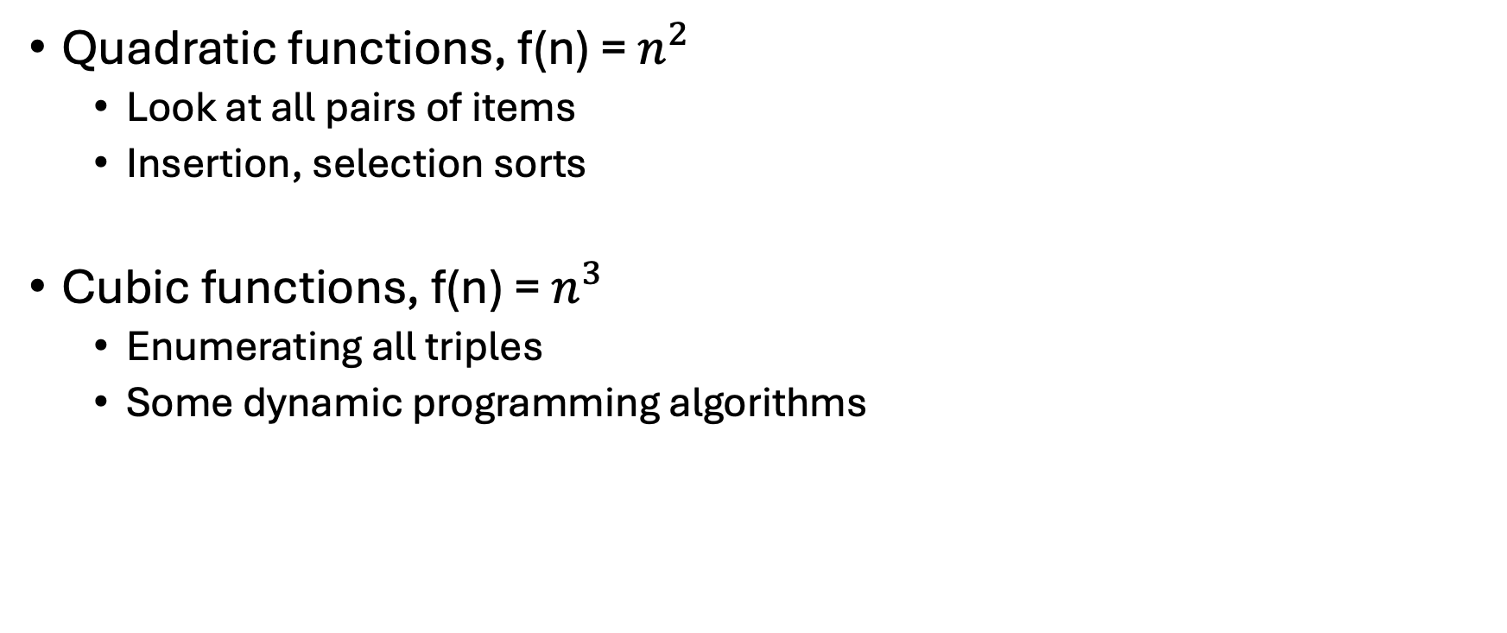
Classes of functions
Quadratic functions, f(n) = $n^{2}$
Look at all pairs of items
Insertion, selection sorts
Cubic functions, f(n) = $n^{3}$
Enumerating all triples
Some dynamic programming algorithms

Slide 54
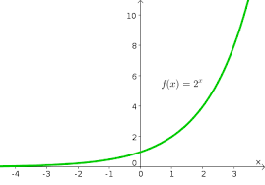
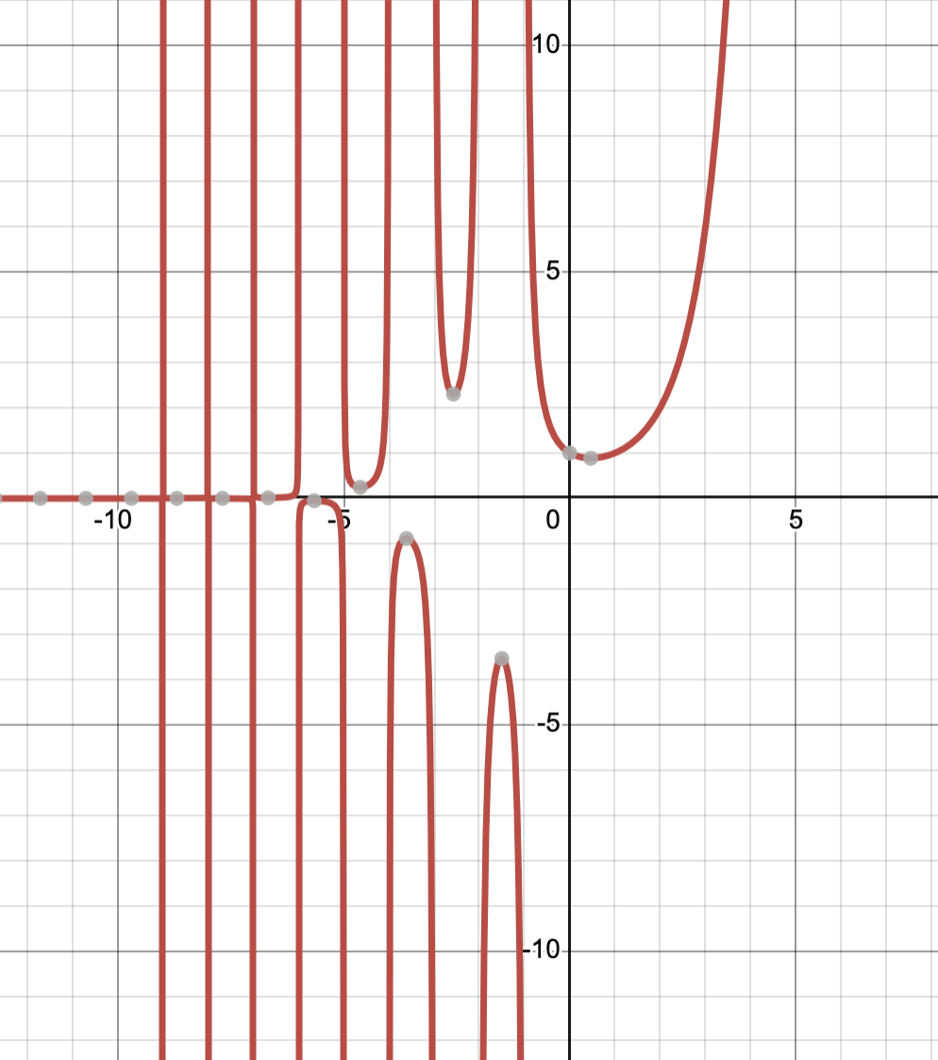
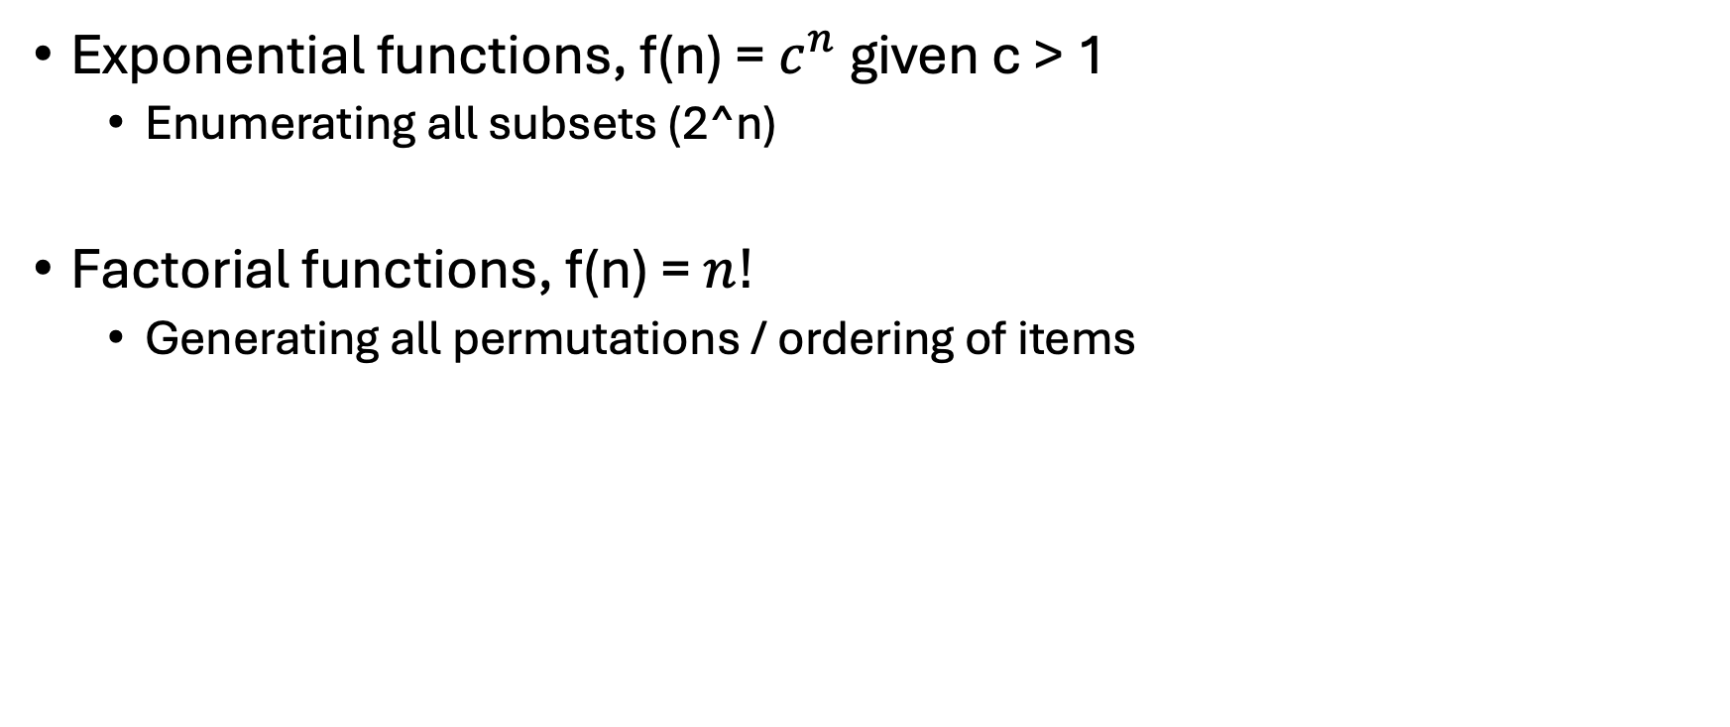
Classes of functions
Exponential functions, f(n) = $c^{n}$ given c > 1
Enumerating all subsets (2^n)
Factorial functions, f(n) = ${n!}^{}$
Generating all permutations / ordering of items

Slide 55
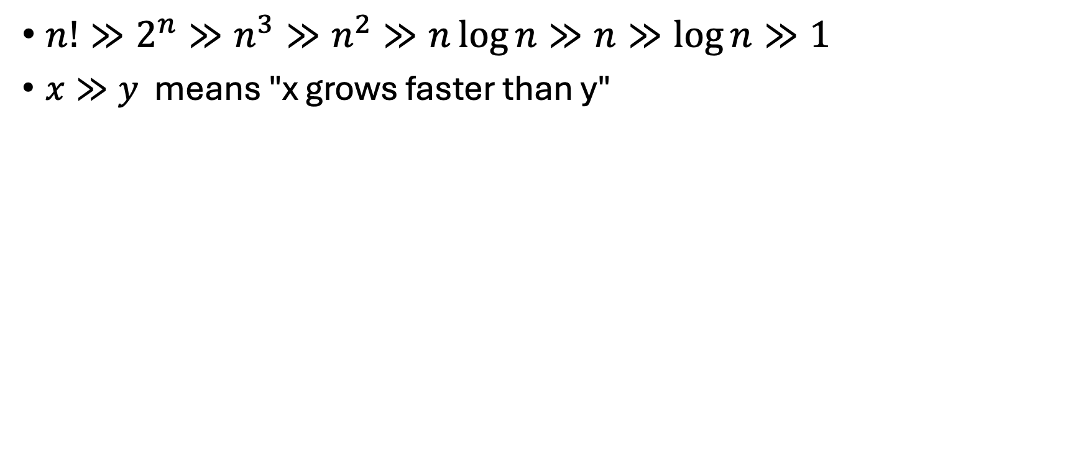
How they relate
$n!≫2^{n}≫n^{3}≫n^{2}≫n\log{n}≫n≫\log{n}≫1$
$x≫y$ means "x grows faster than y"

Slide 56
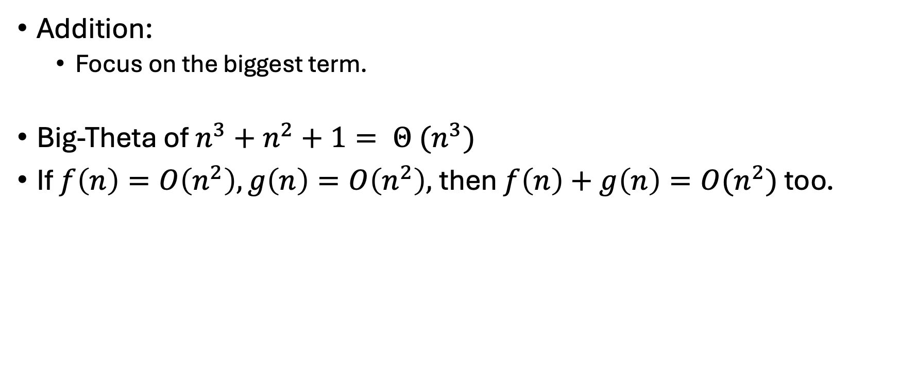
Working with these functions
Addition:
Focus on the biggest term.
Big-Theta of $n^{3}+n^{2}+1= Θ (n^{3})$
If $f\left(n\right)=O\left(n^{2}\right), g\left(n\right)=O\left(n^{2}\right),$then $f\left(n\right)+g\left(n\right)=O(n^{2})$ too.

Slide 57
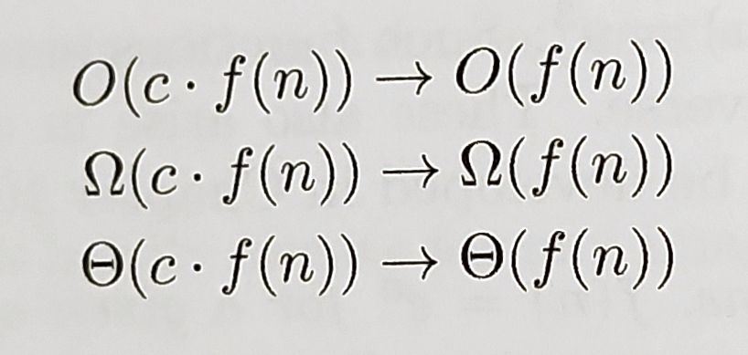
Ignore the constants
Multiplying by a constant does not change the asymptotics.

Slide 58
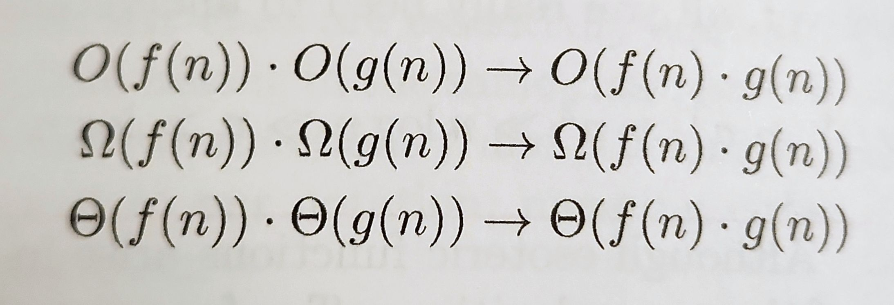
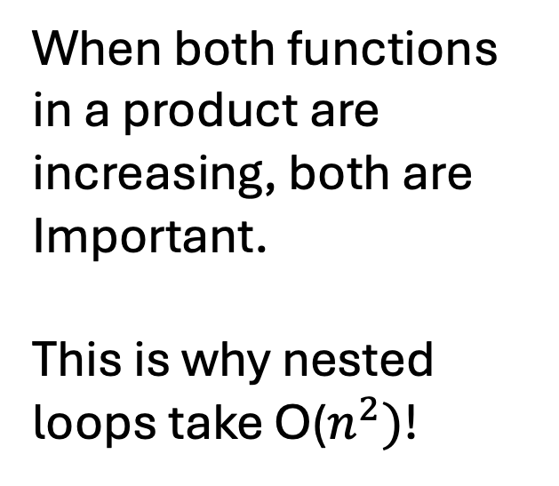
When both functions in a product are increasing, both are
Important.
This is why nested loops take O($n^{2})$!

Slide 59
Tools we need
Summations
Logarithms
Notes:
Since not everyone has calc 2 experience, we'll kind of gloss over this…but I'll tell you about this and if it becomes an issue later we'll go over it.

Slide 60
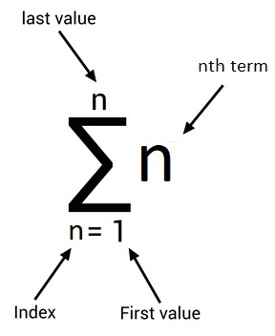
Summations
Help us add things up
Notes:
Like a for loop
Sum ( c)
Sum (i) = n(n-1)/2

Slide 61
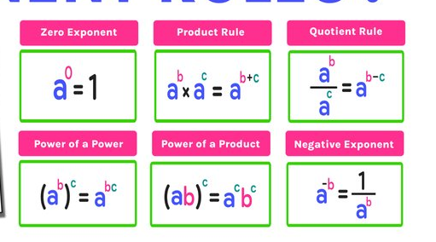
Exponents
From: mashupmath

Slide 62
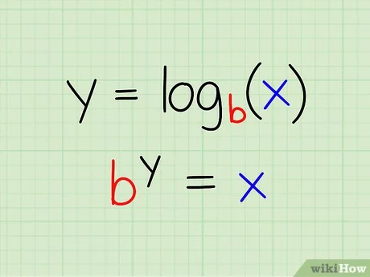
Logarithms
Repeated divisions.

